Slide 1

Exploring Reinforcement Learning Solutions for EV-aware Optimal Power Flow Under Uncertainty Master Thesis Mid-term Presentation
Chia-Ling Yang
Technical University Munich (TUM)
Chair of Production and Supply Chain Management
Prof. Dr. Martin Grunow
Superviosr: Bahar Okumusoglu
Munich, ^{th} of August 2024

Slide 2
Agenda
Background
Problem Formulation
RL Fundamentals
Literature Review
Methodology
Implementation – Training Preliminary Result?
Outlook
Chia-Ling Yang | Exploring Reinforcement Learning Solutions for EV-aware Optimal Power Flow Under Uncertainty

Slide 3
Background

Slide 4

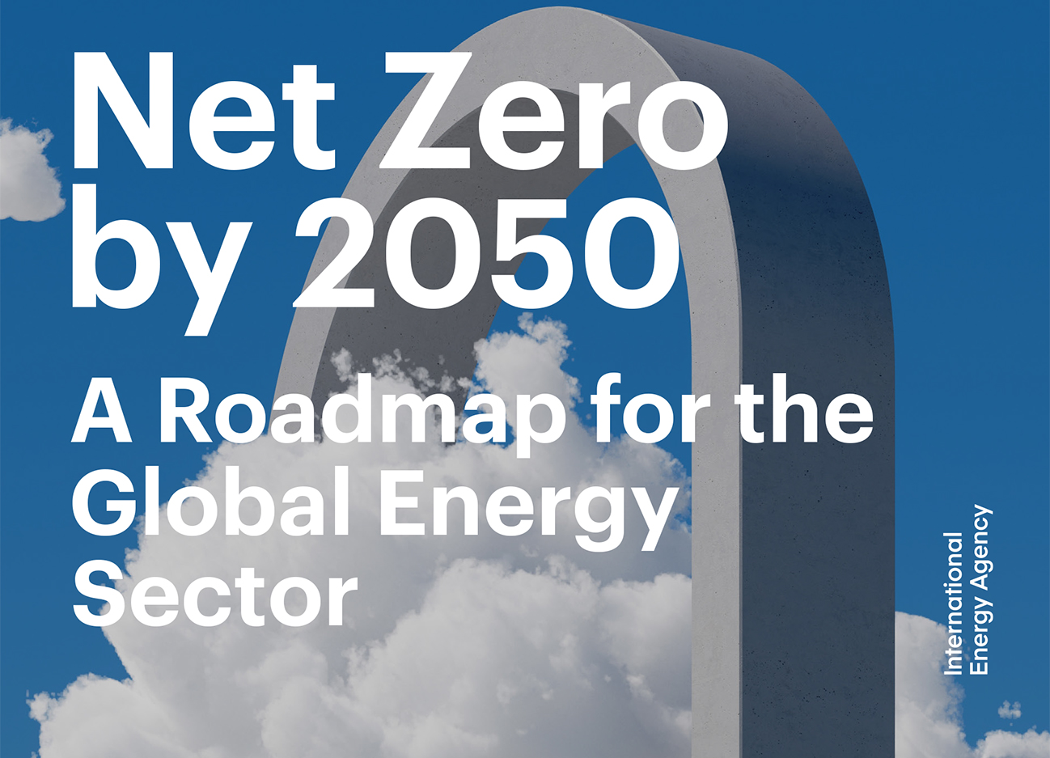



Background
Problem Formulation
Literature Review
Methodology
Outlook
Renewable Energy Integration
Bouckaert et al. (2021) "Net zero by 2050: A roadmap for the global energy sector."
Low Carbon Emission Transportation
Chia-Ling Yang | Exploring Reinforcement Learning Solutions for EV-aware Optimal Power Flow Under Uncertainty
Notes:
A roadmap for global energy sector proposed by International Energy Agency

Slide 5

“Security- and Human-centered Energy Transition”
Background
Problem Formulation
Literature Review
Methodology
Outlook
IEA (2023). “World Energy Outlook 2023” https://www.iea.org/reports/world-energy-outlook-2023
Rising Importance of Distribution System/Network Operator (DSO)
Decentralization
Renewable Energy Integration
High Uncertainty
Energy Demand
Instability of Distribution Network
Fast Charging
Extreme Weather
Low Carbon Emission Transportation
Chia-Ling Yang | Exploring Reinforcement Learning Solutions for EV-aware Optimal Power Flow Under Uncertainty
Notes:
Who cares about the problem? Why is the problem important for them?
Important for DSO
If not carefully taken care: cascading failure, prompt break down

Slide 6
Problem Formulation

Slide 7






Background
Problem Formulation
Literature Review
Methodology
Outlook
OPF
Load
DSO
Generation
Battery
Chia-Ling Yang | Exploring Reinforcement Learning Solutions for EV-aware Optimal Power Flow Under Uncertainty

Slide 8
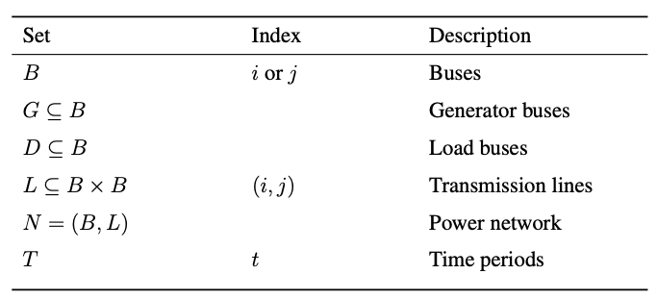
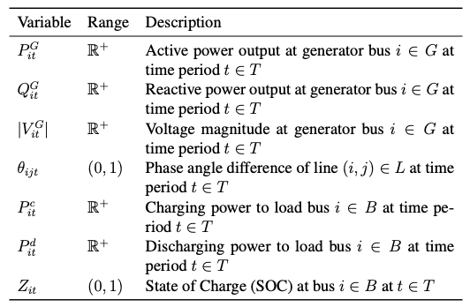
Optimal Power Flow
Background
Problem Formulation
Literature Review
Methodology
Outlook
Set and index
Decision variable
Chia-Ling Yang | Exploring Reinforcement Learning Solutions for EV-aware Optimal Power Flow Under Uncertainty

Slide 9
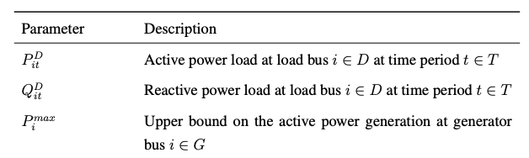
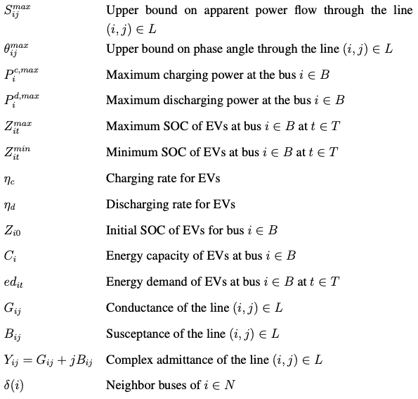
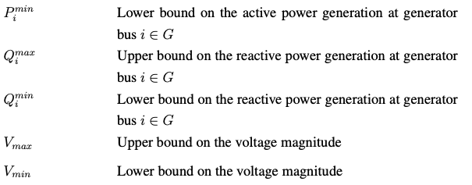
Optimal Power Flow
Background
Problem Formulation
Literature Review
Methodology
Outlook
Parameters
Chia-Ling Yang | Exploring Reinforcement Learning Solutions for EV-aware Optimal Power Flow Under Uncertainty

Slide 10
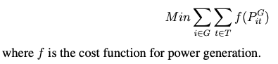
Optimal Power Flow
Background
Problem Formulation
Literature Review
Methodology
Outlook
Objective Function
Chia-Ling Yang | Exploring Reinforcement Learning Solutions for EV-aware Optimal Power Flow Under Uncertainty

Slide 11
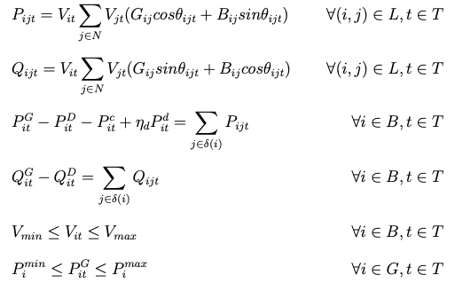
Optimal Power Flow
Background
Problem Formulation
Literature Review
Methodology
Outlook
Constraints
Active power calculation of lines
Reactive power calculation of lines
Active power balance at nodes
Reactive power balance at nodes
Voltage limitation at nodes
Active power generation limitation
Chia-Ling Yang | Exploring Reinforcement Learning Solutions for EV-aware Optimal Power Flow Under Uncertainty

Slide 12
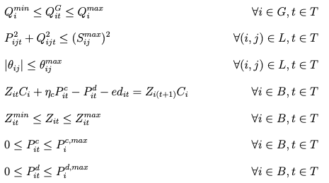
Optimal Power Flow
Background
Problem Formulation
Literature Review
Methodology
Outlook
Constraints
Reactive power generation limitation
Apparent power (line load) limitation
Phase angle limitation
Energy balance of EV charging
State of charge (SOC) limitation
Charging limitation
Discharging limitation
Chia-Ling Yang | Exploring Reinforcement Learning Solutions for EV-aware Optimal Power Flow Under Uncertainty

Slide 13
Reinforcement Learning (RL) provides potentials to tackle the non-convex, non-linear OPF problem with high uncertainty in the real world.
Background
Problem Formulation
Literature Review
Methodology
Outlook
Solving OPF is challenging
RL is a promising.
Non-convexity
Non-Linearity
Uncertainty
Robustness
Fast implementation online
Chia-Ling Yang | Exploring Reinforcement Learning Solutions for EV-aware Optimal Power Flow Under Uncertainty

Slide 14








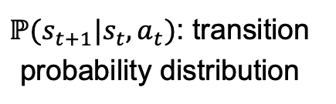


Markov Decision Process
$s_{t}:$ state
$a_{t}:$ action
$$ℙ(s_{t+1}|s_{t},a_{t})$$
Environment
$$s_{t}$$
$$s_{t+1}$$
$ℙ(s_{t+1}|s_{t},a_{t})$: transition probability distribution
$$a_{t}$$
$$r_{t}$$
Agent
$r_{t}$: reward
$$π(a_{t}|s_{t})$$
$π\left(a_{t} | s_{t}\right):$ policy
Chia-Ling Yang | Exploring Reinforcement Learning Solutions for EV-aware Optimal Power Flow Under Uncertainty

Slide 15








Actor-Critic Framework
$$π(a|s;θ)$$
$$V\left(s;w\right)≅V(s)$$
$$V(s)$$
$$a$$
Actor
Critic
$$a$$
$$r$$
$$s$$
$$s^{′}$$
Environment
Chia-Ling Yang | Exploring Reinforcement Learning Solutions for EV-aware Optimal Power Flow Under Uncertainty

Slide 16
Literature Review

Slide 17
Background
Problem Formulation
Literature Review
Methodology
Outlook
Title | Author | Journal | Year | Methodology | EV | RL | Without DC Approximation
The Promise of EV-Aware Multi-Period OPF Problem: Cost and Emission Benefits | Kayacık et al. | Sustainable Energy, Grids and Networks | 2023 | Second-Order Cone Programming (SOCP) | X
Symbiotic organisms search algorithm-based security-constrained AC–DC OPF regarding uncertainty of wind, PV and PEV systems | Duman et al. | Soft Computing | 2021 | Heuristic: Symbiotic Organisms Search | X
Optimal charging of electric vehicles in smart grid: Characterization and valley-filling algorithms | Chen et al. | 2012 IEEE SmartGridComm | 2012 | Heuristic: Valley-Filling Algorithm | X
Real-Time Optimal Power Flow: A "Lagrangian" Based Deep Reinforcement Learning Approach | Yan and Xu | IEEE Transactions on Power Systems | 2020 | Deep Deterministic Policy Gradient |  | X
A Data-driven Method for Fast AC Optimal Power Flow Solutions via Deep Reinforcement Learning | Zhou et al. | Journal of Modern Power Systems and Clean Energy | 2020 | Proximal Policy Optimization (PPO) |  | X
Feasibility Constrained Online Calculation for Real-Time Optimal Power Flow: A Convex Constrained Deep Reinforcement Learning Approach | Sayed et al. | IEEE Transactions on Power Systems | 2023 | Soft Actor-Critic |  | X
Network-Constrained Reinforcement Learning for Optimal EV Charging Control | Wu et al. | 2023 IEEE SmartGridComm | 2023 | Twin Delayed Deep Deterministic Policy Gradient (TD3) | X | X
This work |  |  |  | PPO | X | X | X
Chia-Ling Yang | Exploring Reinforcement Learning Solutions for EV-aware Optimal Power Flow Under Uncertainty

Slide 18
Methodology

Slide 19
PPO
Chia-Ling Yang | Exploring Reinforcement Learning Solutions for EV-aware Optimal Power Flow Under Uncertainty

Slide 20
Implementation - Training

Slide 21
Critical Components in RL
Environment:
State:
Action:
Reward:
Chia-Ling Yang | Exploring Reinforcement Learning Solutions for EV-aware Optimal Power Flow Under Uncertainty

Slide 22
Uncertainty
Renewable power generation
Power consumption
Charging/discharging demands
Chia-Ling Yang | Exploring Reinforcement Learning Solutions for EV-aware Optimal Power Flow Under Uncertainty

Slide 23
Assumptions
Chia-Ling Yang | Exploring Reinforcement Learning Solutions for EV-aware Optimal Power Flow Under Uncertainty

Slide 24
Neural Network Architechture
Chia-Ling Yang | Exploring Reinforcement Learning Solutions for EV-aware Optimal Power Flow Under Uncertainty

Slide 25
Training Performance
Chia-Ling Yang | Exploring Reinforcement Learning Solutions for EV-aware Optimal Power Flow Under Uncertainty

Slide 26
Outlook

